Slide 1
Section 2.7 Prime Factorization
© Copyright all rights reserved to Homework depot: www.BCMath.ca

Slide 2
How to Count:
Ex: How many different ways can you arrange the three letters: A, B, C
There are three ways to count
Listing out all the possible outcomes
and count how many there are
Make a tree diagram and count
how many different branches
there are
Use the Fundamental Counting
Principles (FCP) to count
ABC
BAC
CAB
ACB
BCA
CBA
6 Different Outcomes!
A
B
C
B C
A C
B A
C
B
C
A
A
B
6 Different Branches
Number of Outcomes =
© Copyright all rights reserved to Homework depot: www.BCMath.ca

Slide 3
The Fundamental Counting Principle?
aka “Rule of Product”
If we have “x” number of ways to do the first task and “y” number of ways to do the second task, then there are “x” times “y” ways to do both tasks.
If there are several different tasks:
“A” – Number of ways to do the first task
“B” – Number of ways to do the second task
“C” – Number of ways to do the third task.... and so on
The total number of different ways to do all the task together will be:
© Copyright all rights reserved to Homework depot: www.BCMath.ca

Slide 4



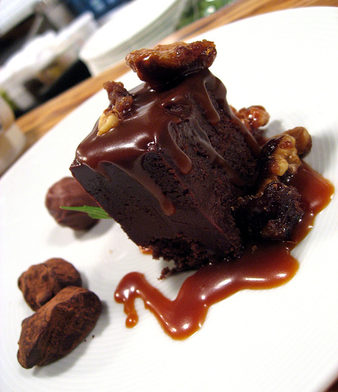
Ex: how many different 3 course meals can you order at the salmon house if there are 3 different appetizers, 4 main course, and 3 different desserts.
There are three different categories: Appetizers, Mains, and Desserts
Use the Fundamental Counting Principles to count how many different
meals are possible
Multiply the number of choices in each
category
© Copyright all rights reserved to Homework depot: www.BCMath.ca

Slide 5
Practice: How many combinations can you make if there are 10 different icings, 16 different ice-creams, and 10 different cones.
FCP: Multiply the number of choices for each category
© Copyright all rights reserved to Homework depot: www.BCMath.ca

Slide 6
II) Finding the Number of Factors from Prime Factorization
Note: All factors can be generated using different combination/products of its prime factors
To find the total number of factors, just think of all the different combinations you can create
© Copyright all rights reserved to Homework depot: www.BCMath.ca

Slide 7
III) Number of factors
To find the number of factors, take the exponent of each prime factor, add one to it, and multiply them
ie: Indicate the number of factors for the following numbers:
© Copyright all rights reserved to Homework depot: www.BCMath.ca

Slide 8
IV) Sum Of all Factors:
To find the sum of all factors, write the number in its prime factorization
Take the power of each prime and find the sum of all its factors
Multiply each sum to get the sum of all factors

Slide 9
Practice: Find the sum of all the factors for each number

Slide 10
Challenge: Find the sum of all the factors for 20!

Slide 11
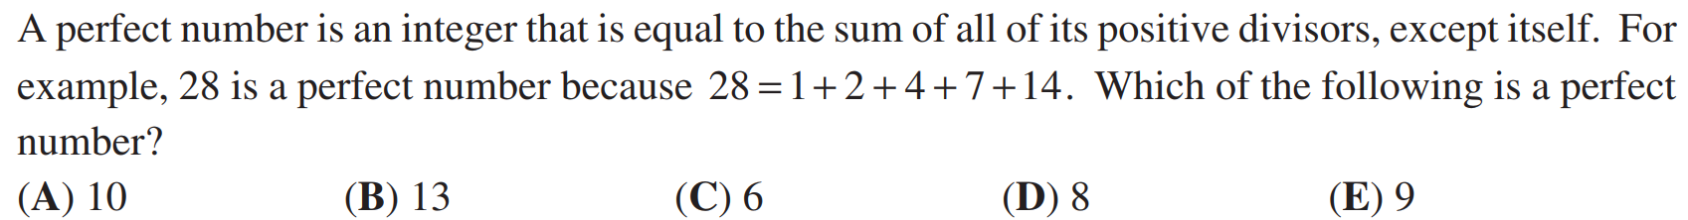

Slide 12
Challenge: A factor of 20! is chosen randomly. What is the probability that the factor is odd?

Slide 13
When “N” is divided by 10, the remainder is 9. When “N” is divided by 9, the remainder is 8.
When “N” is divided by 8, the remainder is 7.
When “N” is divided by 7, the remainder is 6.
When “N” is divided by 6, the remainder is 5.
When “N” is divided by 5, the remainder is 4.
When “N” is divided by 4, the remainder is 3.
When “N” is divided by 3, the remainder is 2.
When “N” is divided by 2, the remainder is 1.
Find the lowest value of “N”

Slide 14
Homework

